Slide 1

IBM Employee Data
Natalie Lopez, Johanna Belmar, Milena Cuao, Tomas Echeverria

Slide 2

Purpose
The purpose of our project aims to efficiently organize IBM employee data into a structured SQL database and establish a date pipeline using Python for data extraction and processing. Our goal is to develop a data management solution that not only simplifies the process of data storage but also enhances the accessibility and usability of the IBM employee data for ongoing analysis and decision-making.
*The data collection was fictionally developed by IBM data scientists.

Slide 3

Why we chose our database
Database Choice
Data Diversity
Customization and Flexibility
Optimized Performance

Slide 4
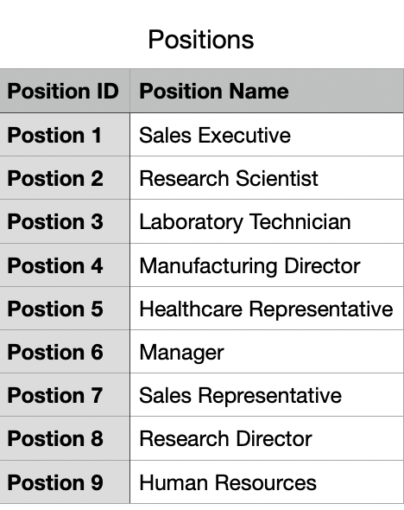
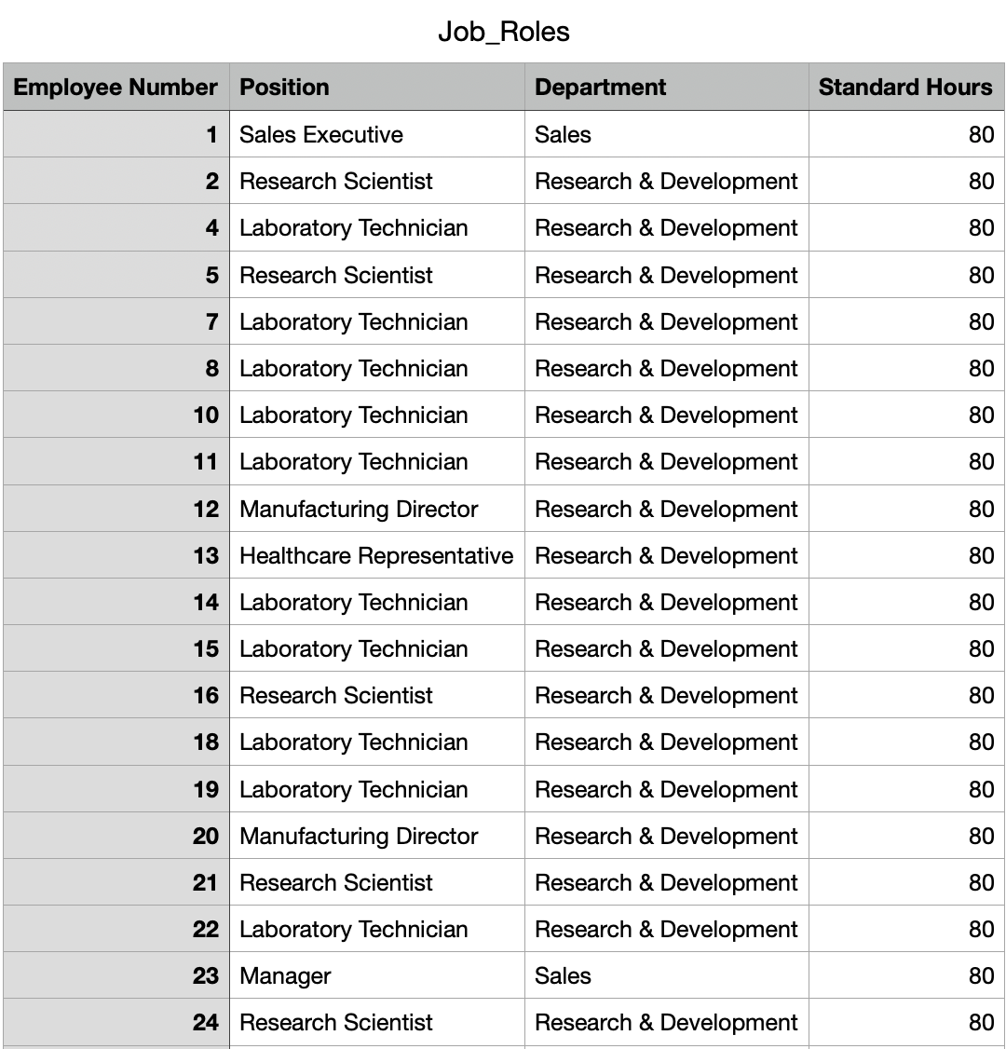
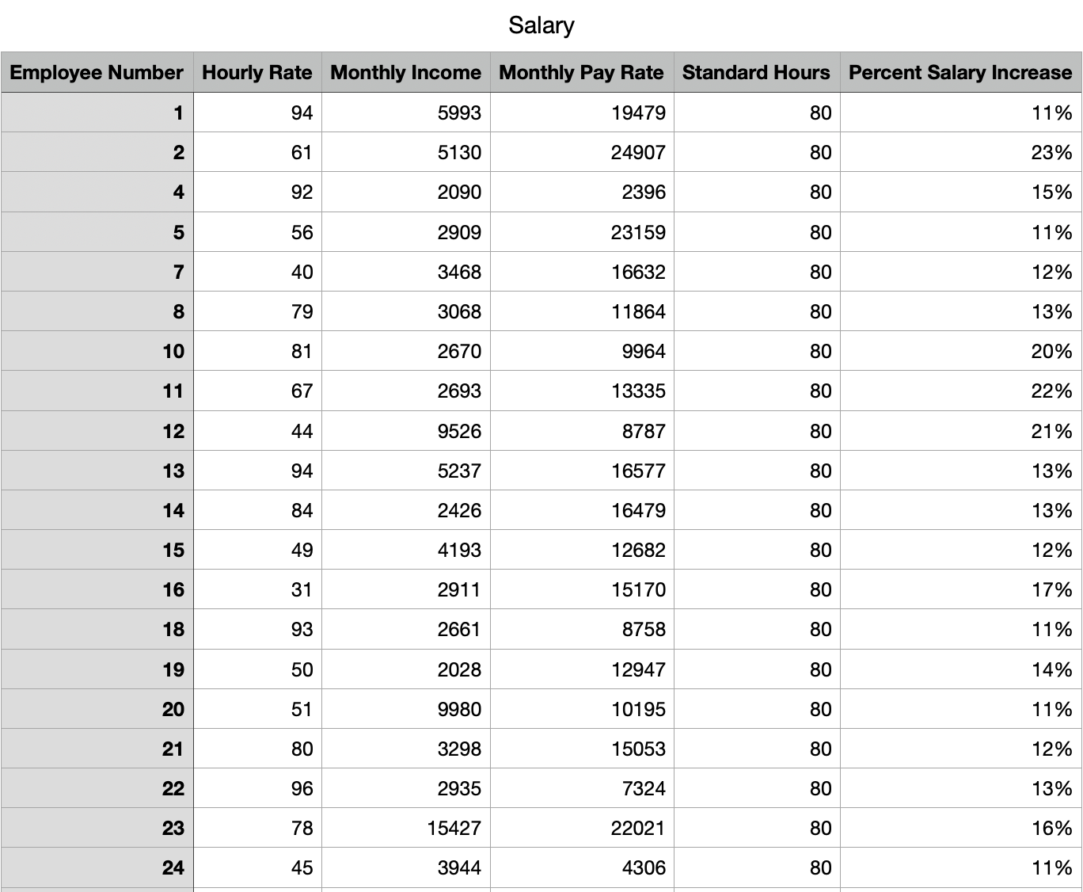
ETA Workflows

Slide 5
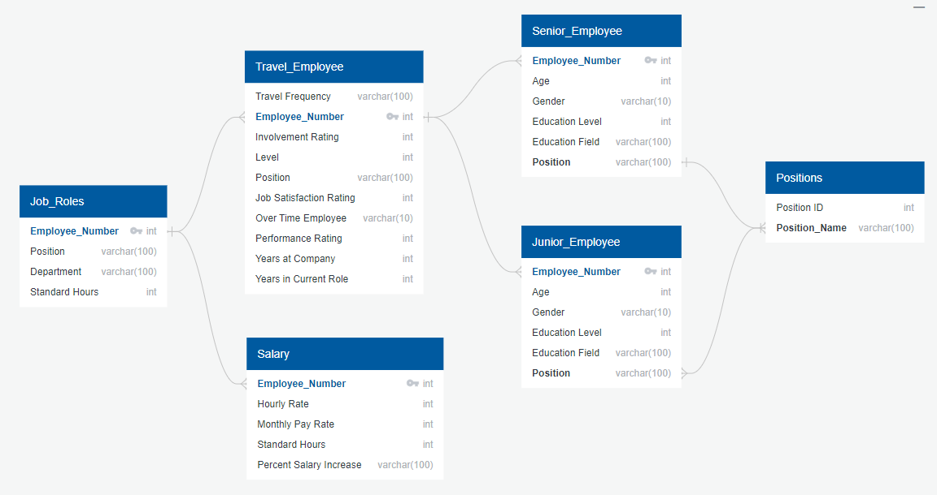
Table Schema

Slide 6
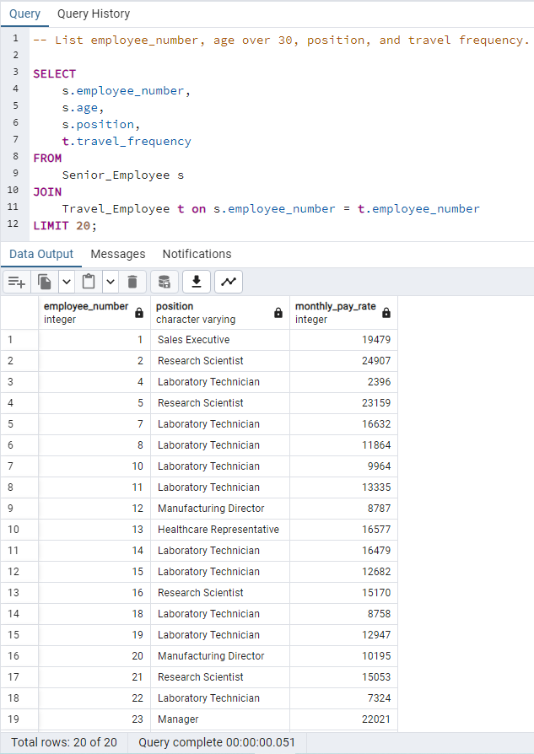
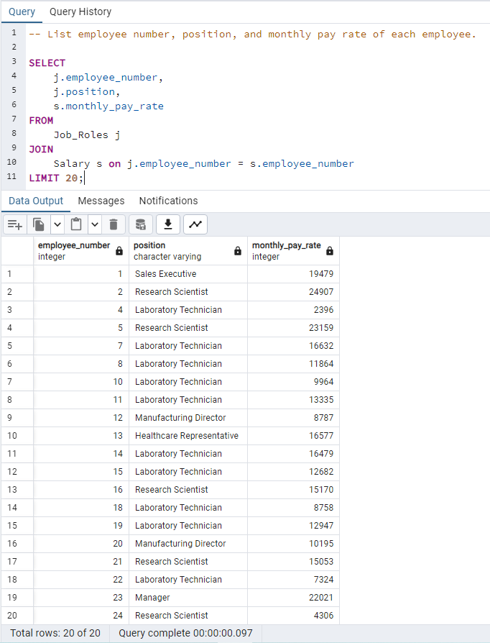
SQL Tables

Slide 7
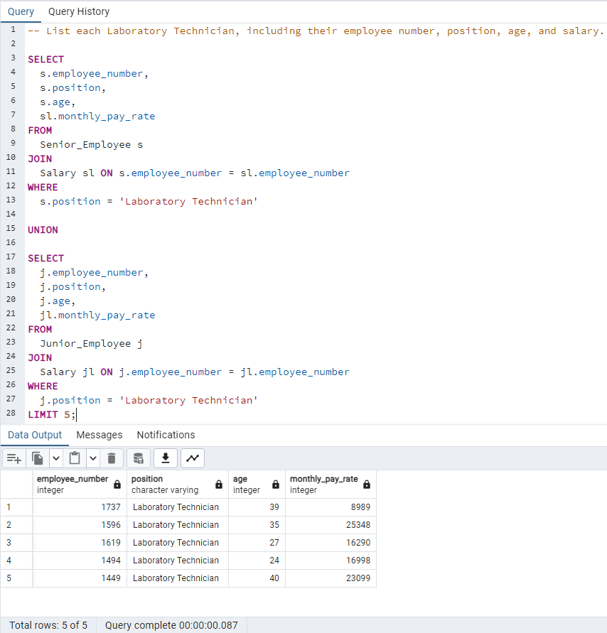
SQL Table

Slide 8
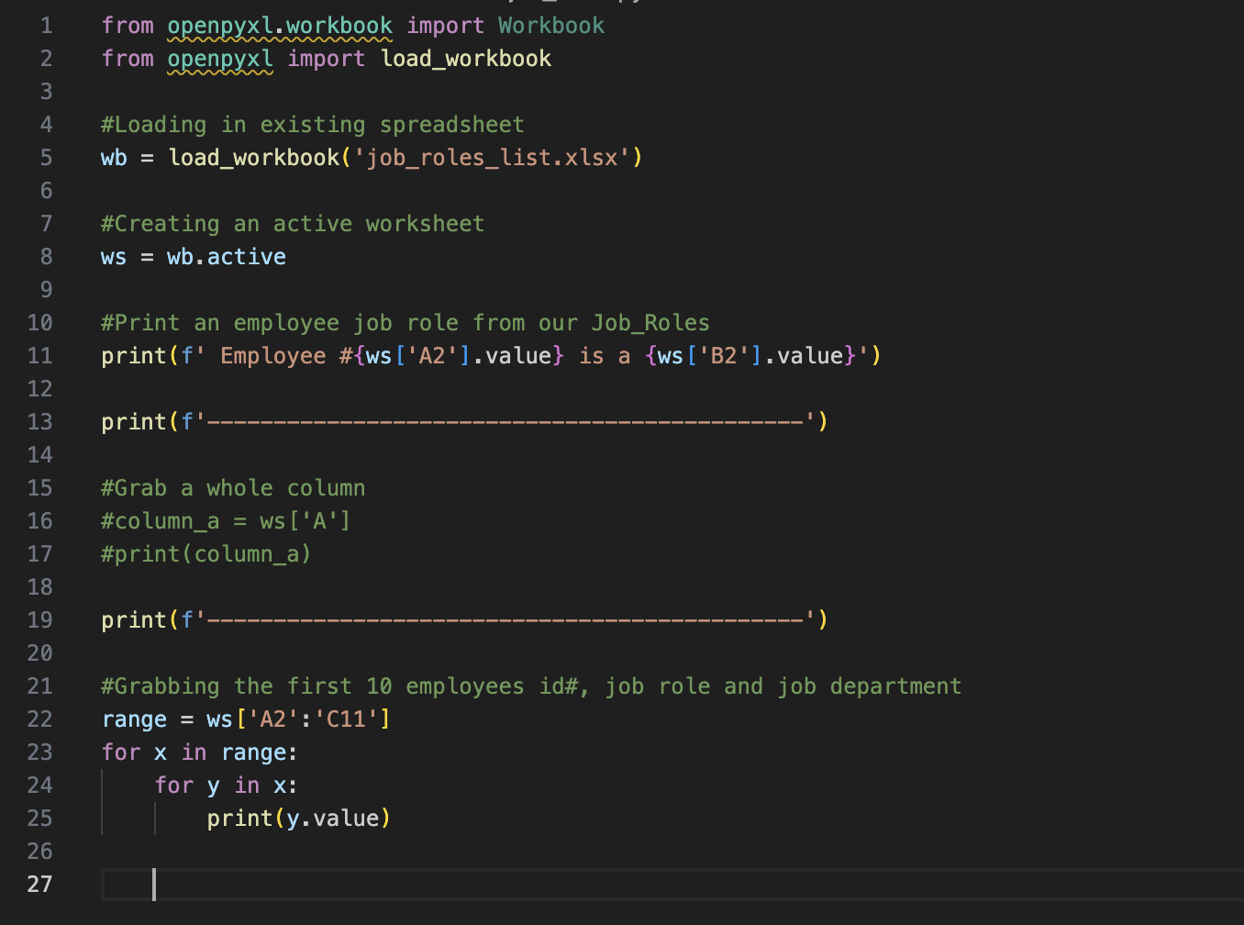
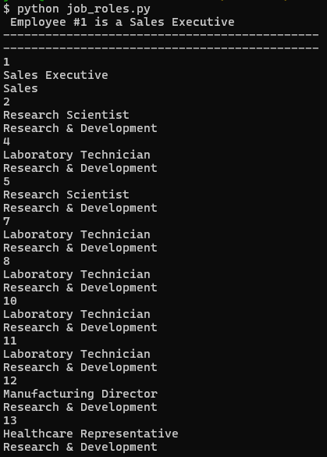
Openpyxl

Slide 9

Ethical Considerations
Ethical Standards and Anonymization
Restricted Access
Transparency and Documentation
Regular Evaluation

Slide 10

Conclusion
Ultimately, by utilizing the pandas dataframe, ETL workflows, SQL, and Openpyxl on the International Business Machines Corporation's (IBM) dataset, we were able to develop a data management system that would simplify the data storage procedure. Furthermore, we were able to pinpoint the factors influencing organizational decision-making.

